Slide 1

GAME PROGRAMMING
Project 1:- Game in HaxeFlixel

Slide 2

MY PROJECT: -
I have created a game ( Gilli danda ) which is basically a 2d single player game using haxeflixel.
It involves a real-time audio-visual experience in some sort of 2-D world.

Slide 3

About the game: -
In the game we have one paddle at the bottom which we can control and can move it left to right.
On the top we have several tiles which we have to break with the ball .
when ball will hit the paddle it will strike up and by which we can break the tiles.

Slide 4
About the game: -
Whenever we will not be able to save the ball from falling down , a message will be prompted on screen “you lose” and the player will lose a point. After that the game will be restarted.
Also between the tile we have placed bullets which player can use to break the tiles, a special ball which will give special advantage to the player and some health kits which will increase the player health bar.
Lastly, if the player will break all the tiles, a message will be prompted “you won” and after which player can either leave the game or can restart it. .

Slide 5

My Game Folder: -
My game folder consists of mainly four sub folders : -
ASSETS : - in which we have stored our images and sound for our game.
EXPORT
SOURCE: - coding part of the game
PRJECT.XML

Slide 6
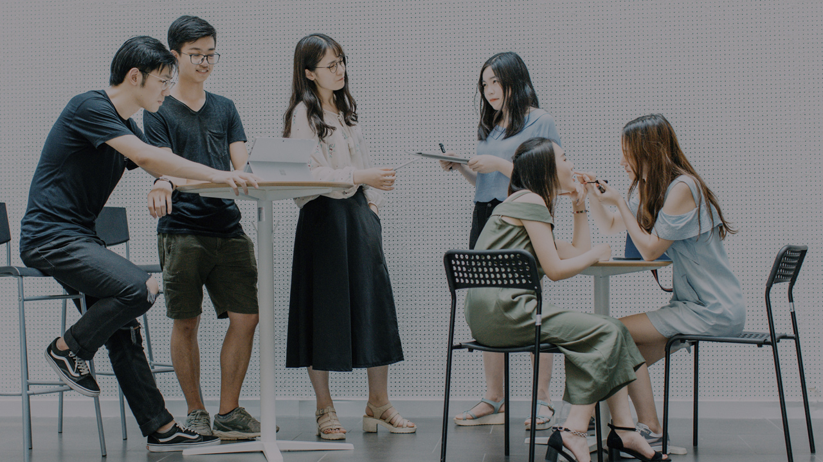
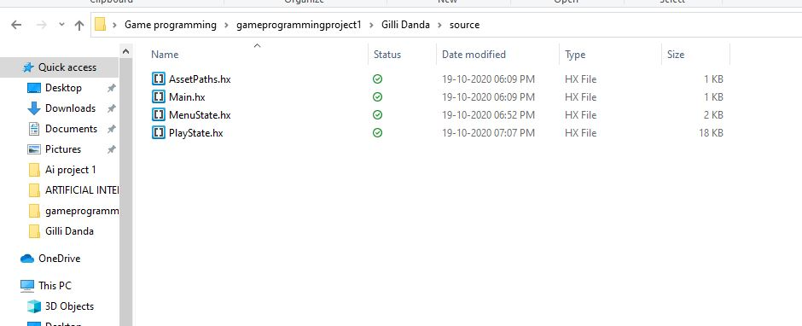
Source folder: -

Slide 7
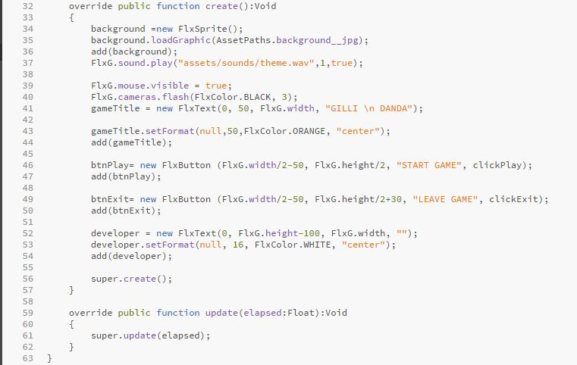

MenuState.hx:-
In the menustate, first i have loaded the background image of the file and given its path from the assets file where we saved all our images.
Then I have set the game name in the center and made two buttons to start the game or leave the game. Also there I have set the color and all the formatting work for the menustate.

Slide 8

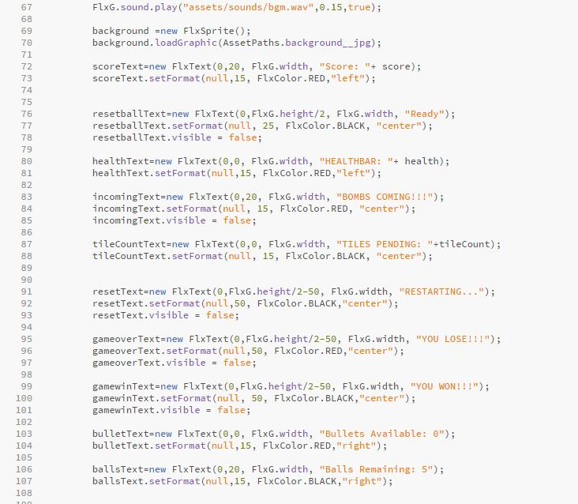
PlayState.hx
In this code I have set the top bar of the game which includes the score, tiles pending, wining and losing message, alert message, health bar, bullets available and numbers of balls remaining data can be seen.
Also, I have set the font size, width, color and all the other formatting work in this code.

Slide 9
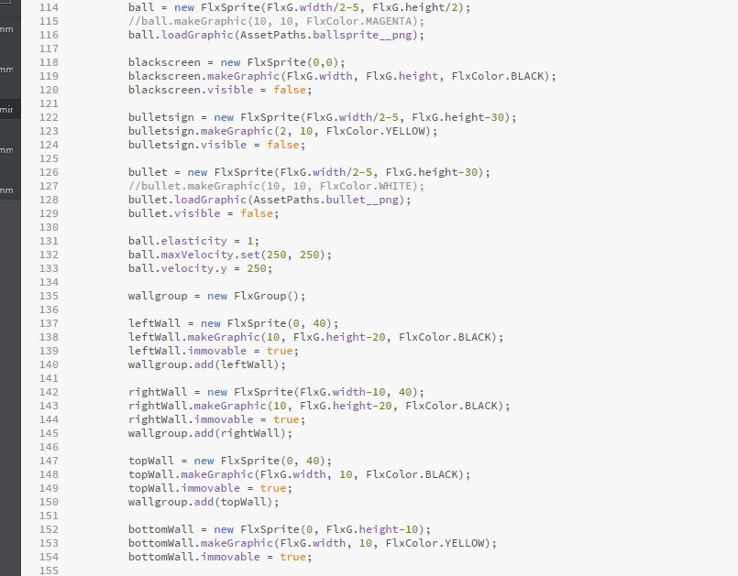
PlayState.hx
In this code I have set the features of the game which includes ball, bullet signs, bullet, ball speed and all the four walls(left,right,top,bottom) .
Also, I have set the ball size and color also same for the walls and all the other formatting work in this code.

Slide 10
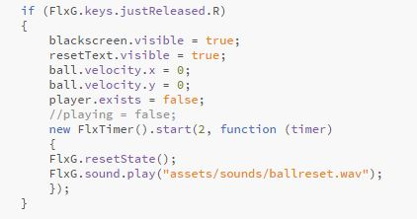
PlayState.hx
In this given code I have set the rules for resetting the play. For example when the balls fops down its speed becomes Zero and it is not visible then the game should be reset.

Slide 11

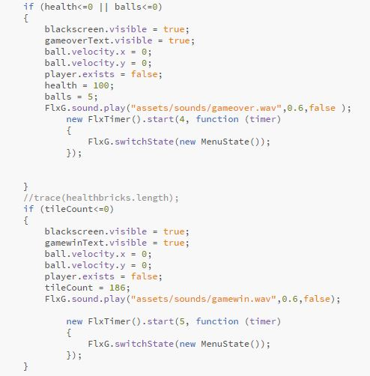
PlayState.hx
Lastly, I have set the logic for winning and losing of the game.
If the velocity of the ball is 0 , health is used 100% and all 5 balls are used than it will play the sound and prompt the text “ game over”.
If the backscreen is visible, all tiles count are completed, then it will play the sound and prompt the text “you win”.

Slide 12
Running the game: -
At the end after all the coding is done, we will open the command prompt and change the directory where our game folder is stored. Then after we will test our game using neko.

Slide 13

GLIMPSE ON THE OUTPUT: -

Slide 14
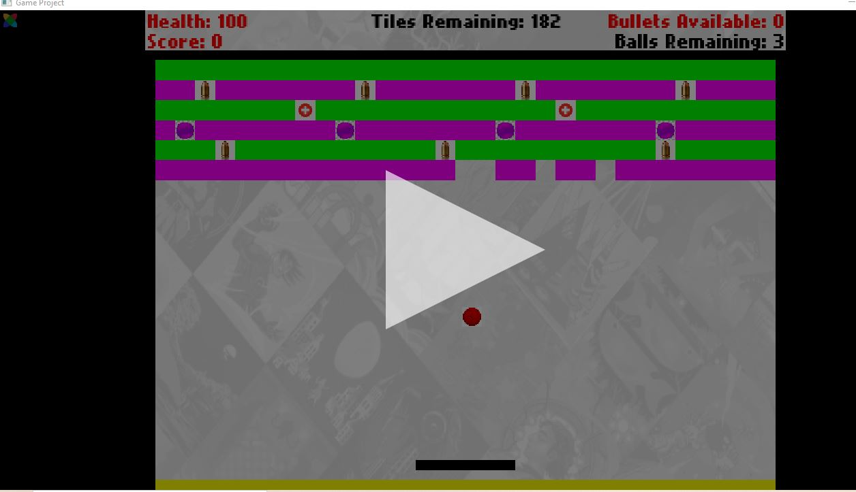
GLIMPSE ON THE OUTPUT: -

Slide 15
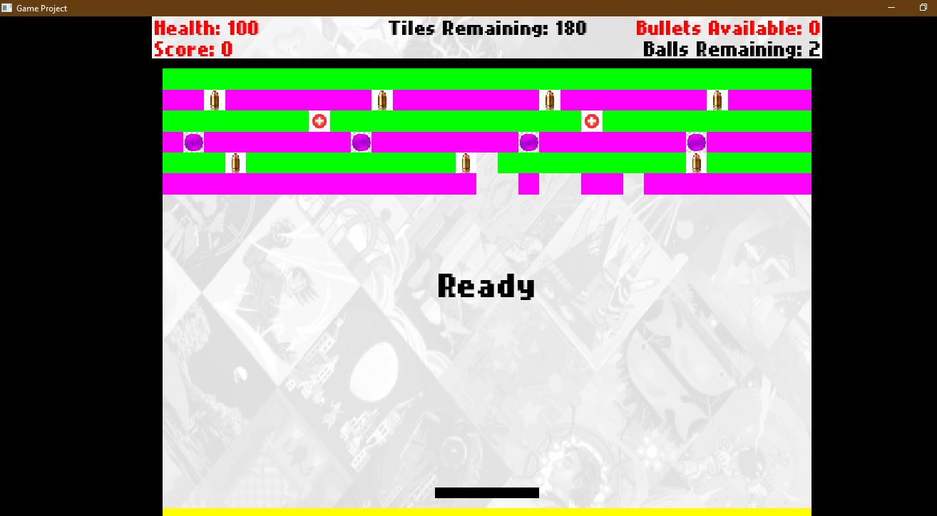
GLIMPSE ON THE OUTPUT: -

Slide 16

Thank You!
Name: - Udbhavsinh Solanki
Id : - 0873798

